Slide 1
Pre-Apprenticeship at Arkansas Career Training Institute
Karen Breashears and Jonathan Bibb

Slide 2

Role of Vocational Rehabilitation
Identify and recruit participants
Facilitate educational and pre-vocational services needed prior to training

Slide 3

Role of Vocational Rehabilitation
Understand and promote registered apprenticeships as competitive integrated employment
Coordinate support services and accommodations

Slide 4

Role of Employers
Actively participate in the pre-apprenticeship training
Approve the curriculum
Interview participants for RA openings

Slide 5
Define Program
The pre-apprenticeship program at ACTI develops a diverse and skilled workforce by preparing participants to meet the basic qualifications for entry into Registered Apprenticeship (RA).

Slide 6
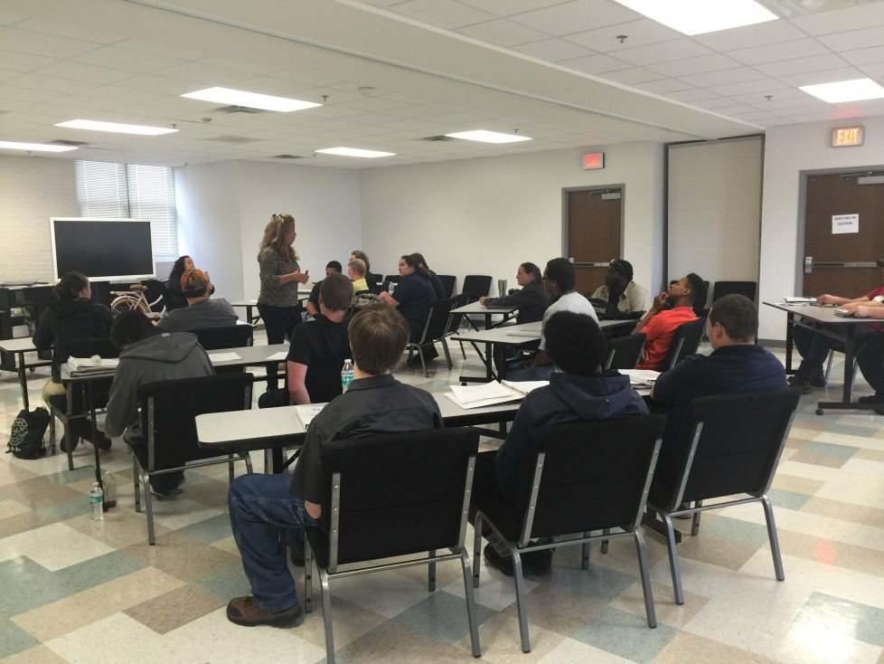
Key Components
Approved Curriculum and Training that aligns with standards of registered apprenticeships

Slide 7

Competencies
Employer Expectations
Employee Responsibilities
Team Building
Workplace Safety
Workplace Scenarios
Interview Techniques

Slide 8
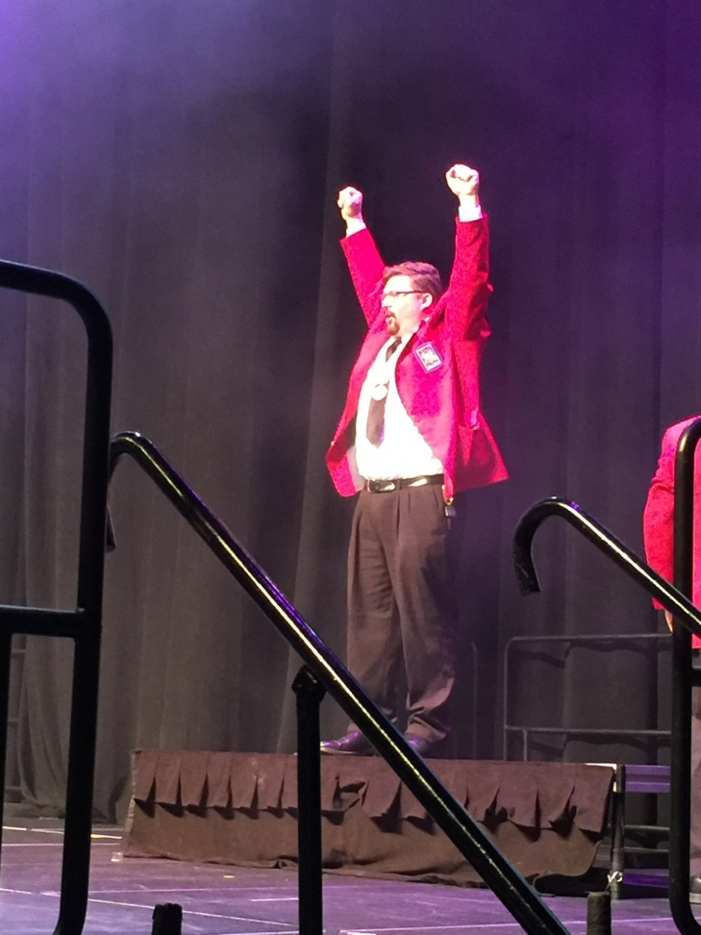
Outcomes
Improved success in vocational education and training
Documented skills gains
Business Engagement
Conduit for competitive integrated employment

Slide 9
Funding
Arkansas Apprenticeship Pathway Initiative (USDOL grant)
Arkansas Expands Apprenticeship (USDOL grant)
Vocational Rehabilitation Grant (USDOE)
Apprenticeship (Employers and Programs)

Slide 10

Customizing the Model for People with Disabilities
Model developed under USDOL Grant to increase diversity in Registered Apprenticeship
Pilot in September 2016 for VR consumers

Slide 11

Implementation Challenges
Building Relationships
Communication
Managing Expectations

Slide 12
Tips for Replication
Identify key stakeholders in Registered Apprenticeship in your state, and build a relationship with them
Do not reinvent the wheel
Help employers and apprenticeship program sponsors meet utilization goals for people with disabilities

Slide 13

Questions

Slide 14
Contact Information
Karen Breashears
Phone: 870-246-0320 Email: Karen@NATF.US Website: WWW.NATF.US
Jonathan Bibb
Phone: 501-701-6310 Email: jonathan.bibb@arkansas.gov Twitter: @jlbibb

